Slide 1
Target Attack 2013
Group 2
By Kwane Galang, Michael Asante, Jonathan Little, Joe Miranda,
Luis Pineda, and Nautica Uribe

Slide 2

Topic Description
Between November 27 and December 15, 2013, hackers accessed Target’s systems. The breach affected 40 million payment card numbers and exposed 70 million personal records. (including names, addresses and emails).
How it Happened:
Target gave Fazio Mechanical POS credentials
Fazio had already been compromised by BlackPOS malware and from there it entered Targets systems
Jonathan Little

Slide 3

Target’s Response
Upon learning of the issue, Target promptly notified affected customers and offered credit monitoring solutions
Target upgraded the security of its systems including switching to chip-and-pin for REDcard
Established new CISO role
Worked closely with law enforcement to improve both Target and industry as a whole
Jonathan Little

Slide 4

Target’s Resolution
Target paid an $18.5 million settlement with 47 states and DC
In accordance with the lawsuit target increase their security, include encrypting customer information
Target paid out millions more in other legal settlements and credit monitoring services
Target improved its security infrastructure including regular audits and stricter third-party vendor management
Due to their early actions and efforts to make things right, Target has regained much of the public’s trust
Jonathan Little

Slide 5
Red Team: Actions Taken
The attack was begun when the red team started to scout for vulnerabilities in Target, which they found in Fazio Mechanical Services
Using stolen credentials, the attackers gained access through targets system, exploiting weak third-party security practices
Once inside they took time to search through Target’s systems and install a specialized piece of malware
Luis Pineda

Slide 6

Actions Taken Cont.
The malware used was called BlackPOS which would scrape credit card data in real time
This process carried on for several week extracting and exfiltrating the data
The data was encrypted and routed through the Target system’s in a way to reduce the chance of discovery
The entire process was focused to maximize the effect on Target alone
Luis Pineda

Slide 7

Red Team: Achievements
Used 3rd party credentials to gain access to Target’s POS system
Stole over 40 million credit and debit card numbers over 3 weeks
Stole personal identifying information of over 70 million customers, including names addresses and phone numbers
The data was moved to the external servers and later sold
Luis Pineda

Slide 8
Payment Card Industry Data Security Standard (PCI DSS)
Requirement 1: Install and Maintain Network Security Controls.
Requirement 2: Apply Secure Configurations to All System Components.
Requirement 3: Protect Stored Account Data
Requirement 4: Protect Cardholder Data with Strong Cryptography During Transmission Over Open, Public Networks.
Requirement 5: Protect All Systems and Networks from Malicious Software
Requirement 6: Develop and Maintain Secure Systems and Software.
Requirement 7: Restrict Access to System Components and Cardholder Data by Business Need to Know
Requirement 8: Identify Users and Authenticate Access to System Components.
Requirement 9: Restrict Physical Access to Cardholder Data.
Requirement 10: Log and Monitor All Access to System Components and Cardholder Data
Requirement 11: Test Security of Systems and Networks Regularly.
Requirement 12: Support Information Security with Organizational Policies and Programs
Joe M.

Slide 9

Blue Team: Failures
Requirement 1: Install and Maintain Network Security Controls. The attackers accessed the network through a third-party HVAC vendor and navigated Target’s systems due to poor segmentation of sensitive payment systems.
Requirement 6: Develop and Maintain Secure Systems and Software. Security software reportedly generated alerts about suspicious activities, but they were not acted upon immediately, leading to a prolonged compromise.
Requirement 10: Log and Monitor Access to System Components. The attack wasn’t detected by Target’s IT team or security systems in a timely manner, allowing hackers extended access.
Joe M.

Slide 10
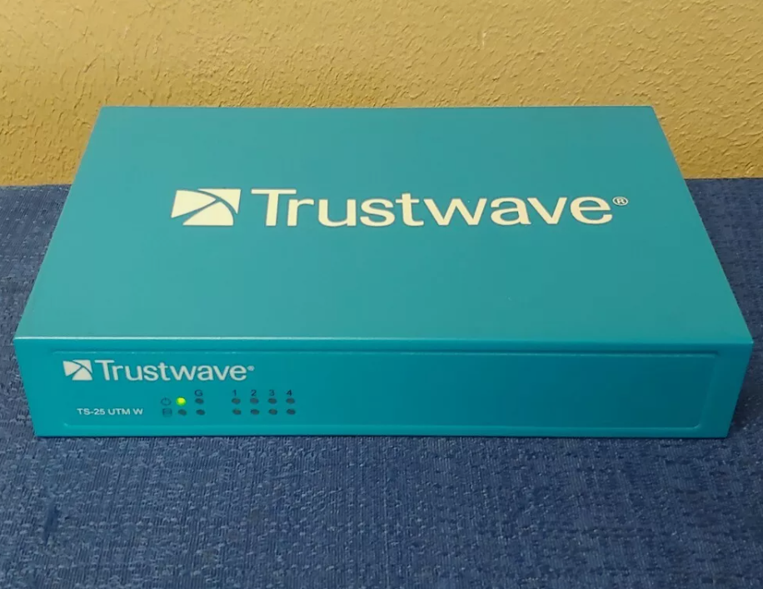
Blue Team: Immediate Actions Taken
Intrusion Response: Eventhough alerts were generated and the response was slow, the intrusion was eventually contained. After three weeks, the breach was detected and addressed.
Coordination with External Security Teams: Target engaged Trustwave, their security vendor, and other external cybersecurity experts to assist with the breach investigation and mitigation.
Joe M.

Slide 11

Blue Team: Recovery
System Restoration: Affected systems were restored after being thoroughly checked and cleaned.
Payment System Overhaul: Target improved its payment processing security to reduce future risks, including implementing chip-and-pin technology.
Customer Support: Target offered credit monitoring services to affected customers to mitigate the impact of stolen data.
Michael A.

Slide 12

Blue team: Preventions
Enhanced Network Segmentation: Implementing stronger segmentation policies to prevent third-party access to sensitive payment systems.
Improved Third-Party Management: Establishing stricter access controls and regular security audits for third-party vendors to avoid unauthorized access points.
Real-Time Threat Detection: Investing in advanced threat detection technologies to identify and respond to potential breaches as they happen
Michael A.

Slide 13

Blue Team: Incident Response Plan
Incident Response Training: Conducting regular training for the internal security team to improve their response to alerts and incidents.
Implementing a Formalized Response Protocol: Developing a structured incident response plan with clear steps for identifying, containing, and mitigating breaches.
Partnership with Security Firms: Establishing partnerships with cybersecurity firms for rapid response capabilities, ensuring external expertise is readily available in case of future incidents.
Michael A.

Slide 14
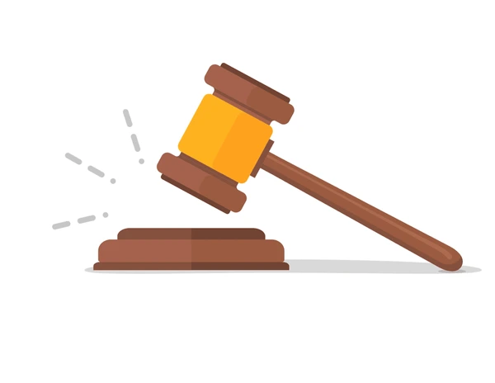
Fallout/damages: Lawsuits
Target was filed in a lawsuit by the Trustmark National Bank and Green Bank in 2013.
The lawsuit mentioned Target's QSA (PCI-approved Qualified Security Assessor), Trustwave, that was expected to observe their systems for signals of unexpected disturbances.
Even though Trustwave delivered “round-the-clock tracking services to catch any attack invasions within Target's programs and incorporations of PII or other classified data” ultimately, over 100 million personal information and/or credit cards were stolen from customers.
This led to 47 U.S. states filing a lawsuit against Target, which contributed to their poor reputation when protecting customers’ private information.
Kwane G.

Slide 15
Fallout/damages: Reputation
Within the span of 3 years, more than 140 lawsuits were filed.
After the data breach in 2013, Target had to pay a settlement of $18.5 million but overall the company lost more than $250 million.
Within the company, many high level employees, including Target’s Ceo, had to step down or were let go.
During the fourth quarter of 2013, specifically the holidays, Target’s earned profits were diminished by 46% by the attack; additionally, the presence of customers shopping decreased as they became wary after the data breach due to the concerns about their credit card security.
These events severely impacted Target’s reputation in the public eye. Years of time and money spent into their cybersecurity infrastructure and PR has allowed it to become a trusted household name once again.
Kwane G.

Slide 16
Rebuilding Target’s Reputation and reclaim Public Trust
Target implemented these procedures within their company to prevent future attacks:
Staff members should understand and practice scam detection and engage in the protection of network and computer security. Keeping track of the networks and paying more attention to disturbing or unexpected patterns in a system’s network is crucial for Target to safeguard their systems and, consecutively, the customer’s data
Warning signs should be implemented and carried out as quickly as possible regarding a cybersecurity response plan that everyone can retrieve.
All in all, taking responsibility in a company or business is essential, especially after a data breach incident, to ensure the safety of shielding their consumers/customers the best way they can to prevent any cyber threats in the future.
Time has allowed for Target’s breach to fade from customer’s minds, however, increased spending into their PCI compliance, PR with their customer relationships, and overall taking responsibility for the issue has allowed them to move forward.
Nautica U.

Slide 17

Conclusion
Target gave network access to a third-party vendor, a small Pennsylvania HVAC company, which did not appear to follow broadly accepted information security practices. The vendor’s weak security allowed the attackers to gain a foothold in Target’s network.
The attackers infiltrated Target's systems using stolen credentials from a third-party HVAC vendor.
Once inside, the attackers installed malware known as BlackPOS on Target's point-of-sale (POS) systems, which was able to steal 40 million different credit card information during transactions and 70 million customer’s personal information.
Target appears to have failed to respond to multiple automated warnings from the company’s anti-intrusion software for weeks, that allowed attackers to instal malware on Target’s system
The primary objective of the attackers was financial gain through the sale of the stolen customer data on black markets.
Through training, payment system restoration, and customer support through credit card monitoring
Target was able to gain the public’s trust again.
Nautica U.

Slide 18

THANK YOU!

